Slide 1

Predicting Election Outcomes Using Social Media Data
Guide: Prof. Chitrakant Banchhor
Capstone Project Review
Shreyas Khairnar(1032180112)
Gopal Joshi(1032180211)
Dhruv Kaliraman(1032180760)
Abhishek Raj(1032180748)

Slide 2
Agenda
Problem Statement
Literature Survey
Methodology
Basic Implementation Details

Slide 3
Problem Statement
Developing a Generalizable Model for Predicting the Election Results using Social Media Data

Slide 4
Literature Review
Title | Authors/ Conference | Methodology | Comments
Prediction of the 2017 French Election Based on Twitter Data Analysis Using Term Weighting | Lei Wang and John Q Gan School of Computer Science and Electronic Engineering, University of Essex, Colchester, UK | Manual tagging of sentiments using domain knowledge and calculating popularity by scoring terms with TF-IDF. | Using term-weighing found to be useful but further analysis needed to analyze the reliability of the model.
2. 2018 Pakistan General Election: Understanding the Predictive Power of Social Media | 2018 12th International Conference on Mathematics, Actuarial Science, Computer Science and Statistics (MACS) | Trained RNN based on previous collection data and the model was used to predict 2018 collections. Text data was vectorized to feed as input. | Predicted the elections with 85% accuracy but cannot generalize the result as it was simulated on only one election.

Slide 5
Literature Review
Title | Authors/ Conference | Methodology | Comments
3. Predicting Brazilian and U.S. Elections with Machine Learning and Social Media Data | Kellyton dos Santos Brito & Paulo Jorge Leitão Adeodato Centro de Informática Universidade Federal de Pernambuco Recife, Brazil | Result ‘r’ of poll at specific day ‘d’ is a function of engagement observed in Candidates Facebook ‘F’, Twitter ‘T’, Instagram ‘I’ in agg. Window of w days prior d. | Based on individual candidates instead of parties. Validation of methodology needed by evaluating the model on multiple elections.
4. A Method for Predicting the Winner of the USA Presidential Elections using Data extracted from Twitter | Lazaros Oikonomou & Lazaros Oikonomou, School of Science & Technology, International Hellenic University, Thermi, Greece | Naive Bayes classifier for sentiment analysis & textblob library for subjectivity analysis. Weights were assigned according to subjectivity of the text. | No accuracy comparison with other classifiers. Engagement as a feature could have improved model.

Slide 6
Literature Review
Title | Authors/ Conference | Methodology | Comments
5. Twitter Based Outcome Predictions of 2019 Indian General Elections Using Decision Tree | Ferdin Joe John Joseph Faculty of Information Technology Thai-Nichi Institute of Technology, Bangkok ferdin@tni.ac.th | Sentiment Classification with Decision Tree Classifier. Popularity is predicted as: Popularity = ((0 x -ve tweets) + (Neutral tweets / 2) + +ve tweets)/Total tweets | Need to analyze regional language data. Trend to be validated by running model on multiple elections.
6. Prediction of 2019 Indian Election Using Sentiment Analysis | Bharat R.Naiknaware & Seema S.Kawathekar, Dept. of Computer Science and IT, Dr. Babasaheb Ambedkar Marathwada University, Aurangabad, India | Sentiment analysis on the development schemes hashtags of then current government and aggregation of all scheme sentiments to predict the results | Cannot be used to identify sentiments for the opposition parties.

Slide 7
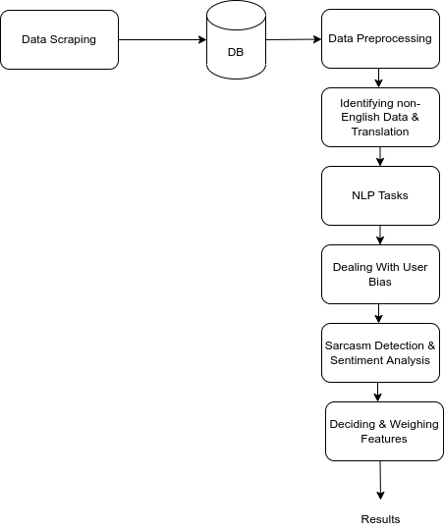
Methodology
Keyword Selection for Data Collection
Data Collection from Twitter
Data Translation for Regional Language data
Data Preprocessing: Natural Language Processing Tasks
Design for Bot Detection for detecting paid posts
Techniques like Sentiment Analysis, Sentiment Intensity, Volume Analysis, Time-Series Analysis
Validating/ Simulating the model on previous elections
Results

Slide 8
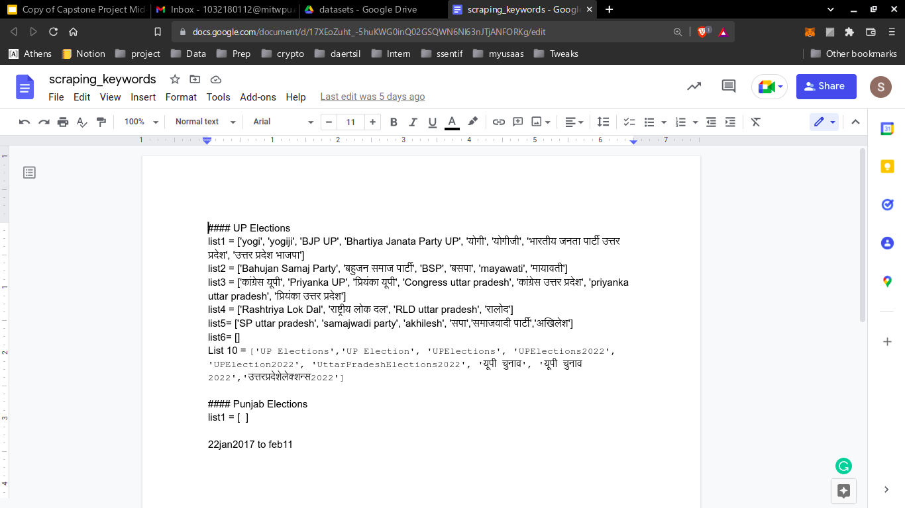
Basic Implementation Details
Data Collection
Keywords were decided for scraping the data using Domain Knowledge
Twitter was used as a data source as it is easy to scrape large volume of data within required time frame
Snscrape library was used to scrape data with the following features: Url, id, datetime, location, username, displayname, verified, followerCount, friendsCount, language, content, bio, likes, retweets, quotes, comments, hashtags

Slide 9
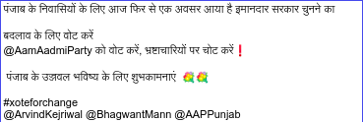
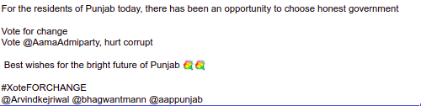
Basic Implementation Details
2. Data Translation
Various translator APIs like googletrans, YandexTranslate, LibreTrans were experimented on sample data
It was observed that googletrans was the most accurate translator with the ability to understand context as it based on the Neural Machine Translation Approach (NMT)
Thus googletrans API was selected for data translation

Slide 10
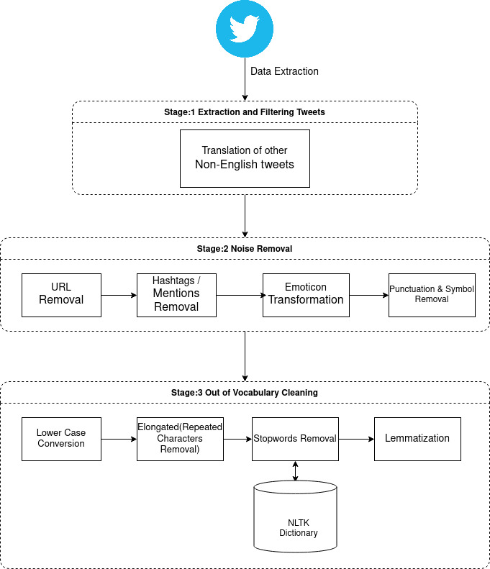
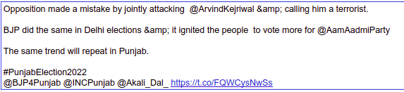
Basic Implementation Details
3. Data Cleaning/ Preprocessing
Important to improve score when passing text as input to any similarity detection measure in NLP

Slide 11
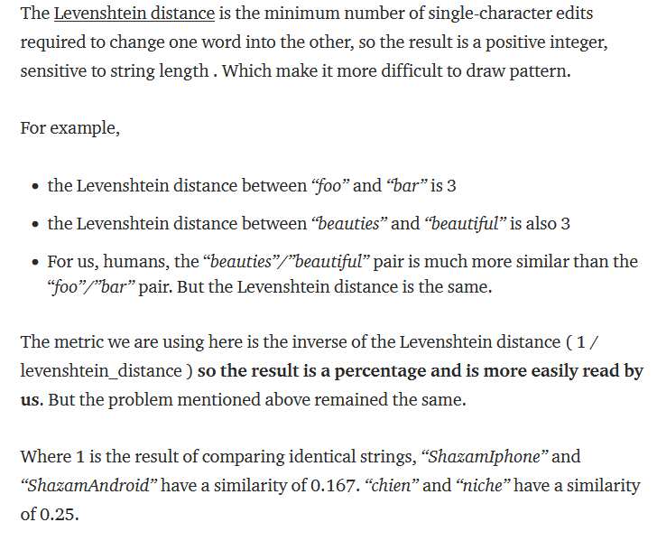
Basic Implementation Details
4. Bias Detection

Slide 12
Basic Implementation Details
5. Sentiment Analysis
Plan to use the latest state-of-the-art BERT model
Fine-tuning pre-trained sentiment analysis model with help of manually labeled data to increase accuracy
BERT is preferred due to its ability to identify context as it is seq-2-seq models

Slide 13
Basic Implementation Details
6. Predicting Results
Producing a weighted score using techniques like Sentiment Analysis, Sentiment Intensity Magnitude, Volume Analysis & Time Series Analysis
Results can be predicted in two ways:
Finding vote share with the help of weighted score
Generalizing the model on multiple elections

Slide 14
References
[1] K. d. S. Brito and P. J. L. Adeodato, "Predicting Brazilian and U.S. Elections with Machine Learning and Social Media Data," 2020 International Joint Conference on Neural Networks (IJCNN), 2020, pp. 1-8, doi: 10.1109/IJCNN48605.2020.9207147.
[2] A. Lopardo and M. Brambilla, "Analyzing and Predicting the US Midterm Elections on Twitter with Recurrent Neural Networks," 2018 IEEE International Conference on Big Data (Big Data), 2018, pp. 5389-5391, doi: 10.1109/BigData.2018.8622441.
[3] F. J. J. Joseph, "Twitter Based Outcome Predictions of 2019 Indian General Elections Using Decision Tree," 2019 4th International Conference on Information Technology (InCIT), 2019, pp. 50-53, doi: 10.1109/INCIT.2019.8911975.
[4] M. Bilal, S. Asif, S. Yousuf and U. Afzal, "2018 Pakistan General Election: Understanding the Predictive Power of Social Media," 2018 12th International Conference on Mathematics, Actuarial Science, Computer Science and Statistics (MACS), 2018, pp. 1-6, doi: 10.1109/MACS.2018.8628445.

Slide 15
References
[5] K. dos Santos Brito, R. L. C. S. Filho and P. J. L. Adeodato, "A Systematic Review of Predicting Elections Based on Social Media Data: Research Challenges and Future Directions," in IEEE Transactions on Computational Social Systems, doi: 10.1109/TCSS.2021.3063660.
[6] M. Tsai, Y. Wang, M. Kwak and N. Rigole, "A Machine Learning Based Strategy for Election Result Prediction," 2019 International Conference on Computational Science and Computational Intelligence (CSCI), 2019, pp. 1408-1410, doi: 10.1109/CSCI49370.2019.00263.
[7] E. Soylu and S. Baday, "Predicting the June 2019 Istanbul Mayoral Election with Twitter," 2020 Innovations in Intelligent Systems and Applications Conference (ASYU), 2020, pp. 1-6, doi: 10.1109/ASYU50717.2020.9259800.
[8] S. M. Srinivasan, R. S. Sangwan, C. J. Neill and T. Zu, "Twitter Data for Predicting Election Results: Insights from Emotion Classification," in IEEE Technology and Society Magazine, vol. 38, no. 1, pp. 58-63, March 2019, doi: 10.1109/MTS.2019.2894472.

Slide 16
References
[9] B. Bansal and S. Srivastava, “On predicting elections with hybrid topic based sentiment analysis of tweets,” Procedia Comput. Sci., vol. 135, no. 2018, pp. 346–353, 2018.
[10] S. Salari, N. Sedighpour, V. Vaezinia, and S. Momtazi, “Estimation of 2017 Iran’s presidential election using sentiment analysis on social media,” in Proc. 4th Iranian Conf. Signal Process. Intell. Syst. (ICSPIS), Dec. 2018, pp. 77–82.
[11] D. Kreiss, R. G. Lawrence, and S. C. McGregor, “In their own words: Political practitioner accounts of candidates, audiences, affordances, genres, and timing in strategic social media use,” Political Commun., vol. 35, no. 1, pp. 8–31, Jan. 2018.
[12] M. Bilal, A. Gani, M. Marjani, and N. Malik, “Predicting elections: Social media data and techniques,” in Proc. Int. Conf. Eng. Emerg. Technol. (ICEET), Feb. 2019, pp. 1–6
[13] J. Kwak and S. K. Cho, “Analyzing public opinion with social media data during election periods: A selective literature review,” Asian J. Public Opin. Res., vol. 5, no. 4, pp. 285–301, 2018.

Slide 17
Thank You !

